Slide 1
Java - Exceptions

Slide 2
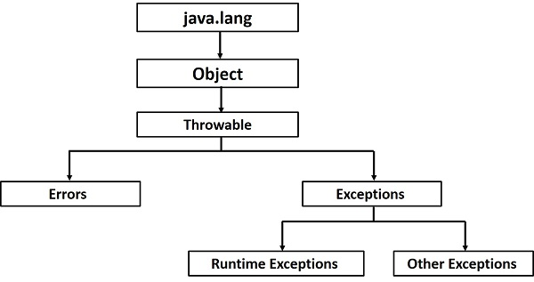

Slide 3
An exception (or exceptional event) is a problem that arises during the execution of a program. When an Exception occurs the normal flow of the program is disrupted and the program/Application terminates abnormally, which is not recommended, therefore, these exceptions are to be handled.

Slide 4
An exception can occur for many different reasons. Following are some scenarios where an exception occurs.
A user has entered an invalid data.
A file that needs to be opened cannot be found.
A network connection has been lost in the middle of communications or the JVM has run out of memory.

Slide 5
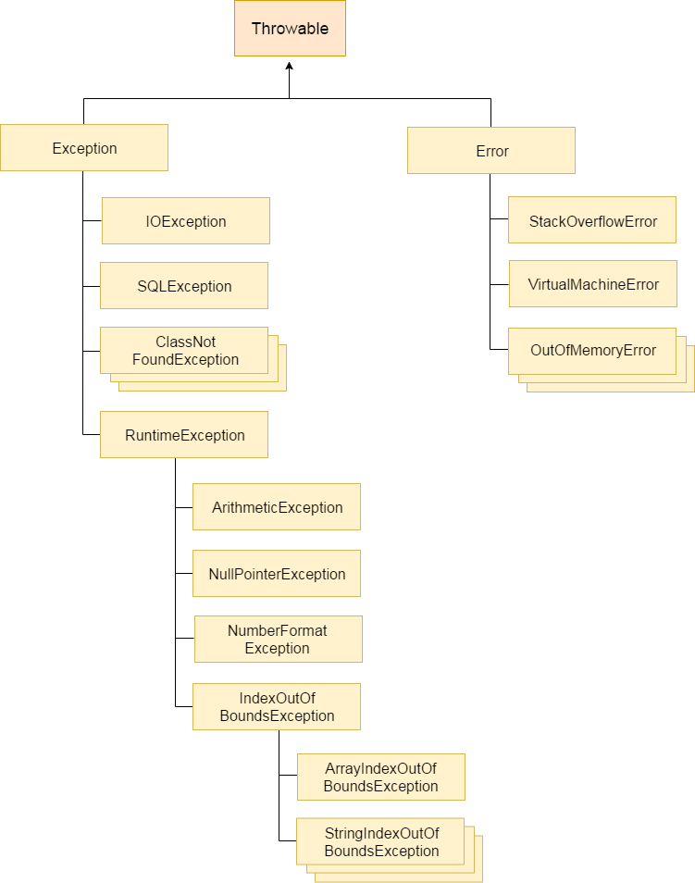

Slide 6
Types of Java Exceptions
There are mainly two types of exceptions: checked and unchecked. Here, an error is considered as the unchecked exception. According to Oracle, there are three types of exceptions:
Checked Exception
Unchecked Exception
Error

Slide 7
Checked Exception
The classes which directly inherit Throwable class except RuntimeException and Error are known as checked exceptions e.g. IOException, SQLException etc. Checked exceptions are checked at compile-time.

Slide 8
Unchecked Exception
The classes which inherit RuntimeException are known as unchecked exceptions e.g. ArithmeticException, NullPointerException, ArrayIndexOutOfBoundsException etc. Unchecked exceptions are not checked at compile-time, but they are checked at runtime.

Slide 9
Error
Error is irrecoverable e.g. OutOfMemoryError, VirtualMachineError, AssertionError etc.

Slide 10
Difference between Checked and Unchecked Exceptions

Slide 11
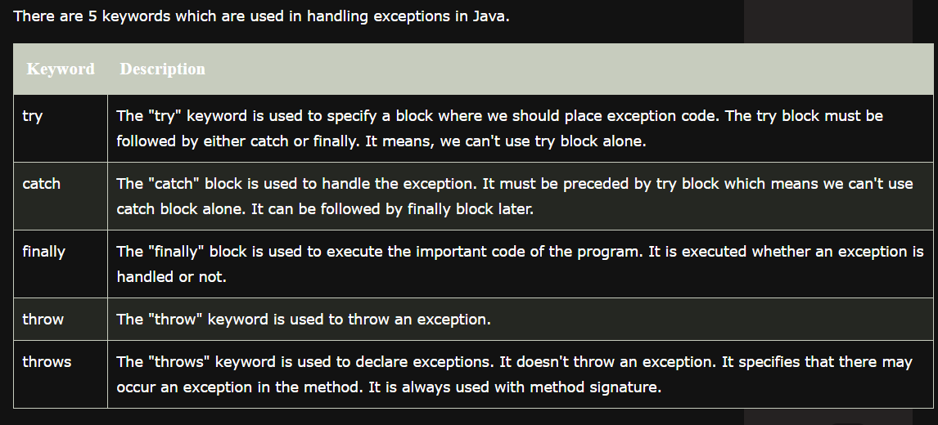
Java Exception Keywords

Slide 12
Java Exception Handling

Slide 13
Java try-catch block

Slide 14
Java Multi-catch block
A try block can be followed by one or more catch blocks. Each catch block must contain a different exception handler. So, if you have to perform different tasks at the occurrence of different exceptions, use java multi-catch block.

Slide 15
Java Nested try block
The try block within a try block is known as nested try block in java.

Slide 16
Java finally block
Java finally block is a block that is used to execute important code such as closing connection, stream etc.
Java finally block is always executed whether exception is handled or not.
Java finally block follows try or catch block.

Slide 17
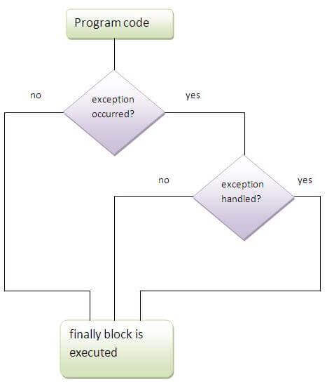

Slide 18
Java throw keyword
The Java throw keyword is used to explicitly throw an exception.
We can throw either checked or uncheked exception in java by throw keyword. The throw keyword is mainly used to throw custom exception. We will see custom exceptions later.

Slide 19
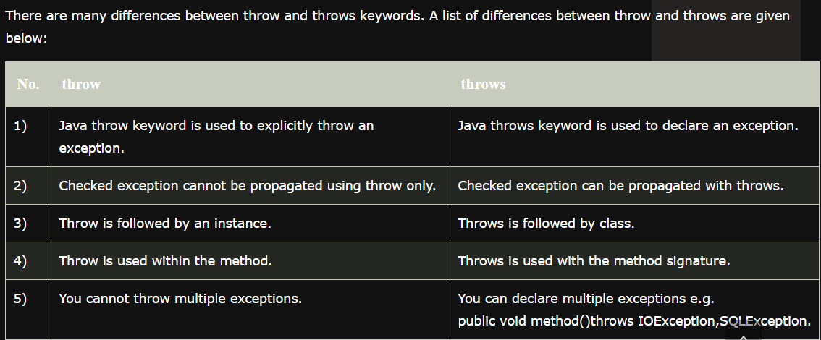
Difference between throw and throws in Java

